Slide 1
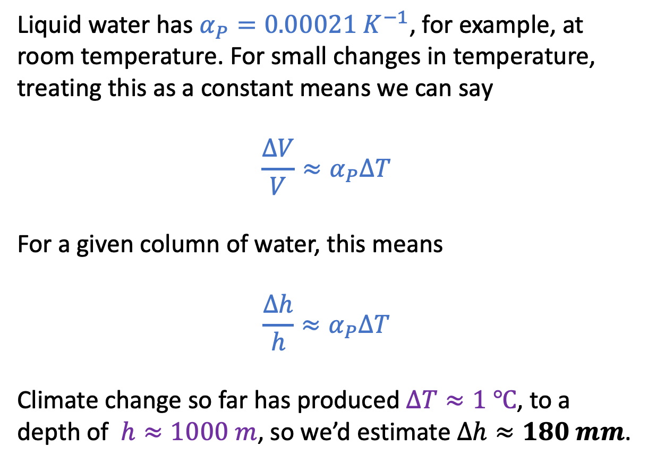


The “Isobaric thermal expansivity”
$$α_{P}≡\frac{1}{V}{\left(\frac{∂V}{∂T}\right)}_{P}$$
Liquid water has $α_{P}=0.00021{ K}^{−1}$, for example, at room temperature. For small changes in temperature, treating this as a constant means we can say
$${\frac{∆V}{V}≈α}_{P}∆T$$
For a given column of water, this means
$${\frac{∆h}{h}≈α}_{P}∆T$$
Climate change so far has produced $∆T≈1 ℃$, to a depth of $h≈1000 m$, so we’d estimate $∆h≈180 mm$.
$$∆h$$
$$h$$

Slide 2
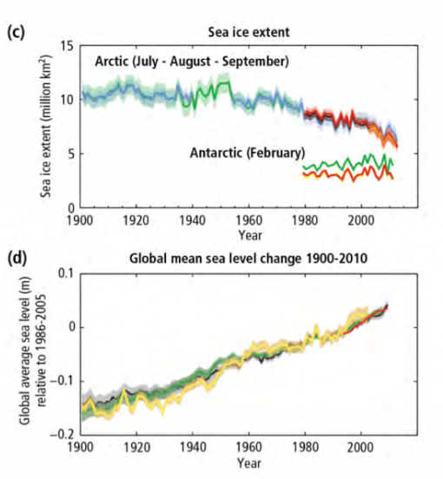
Attribution studies: mainly thermal expansion so far (but melting land ice is a growing fraction)
200 mm (20 cm)
http://assets.climatecentral.org/images/made/11_2_14_upton_ipcc_synthesis_figure_1.1_1050_552_s_c1_c_c.png

Slide 3
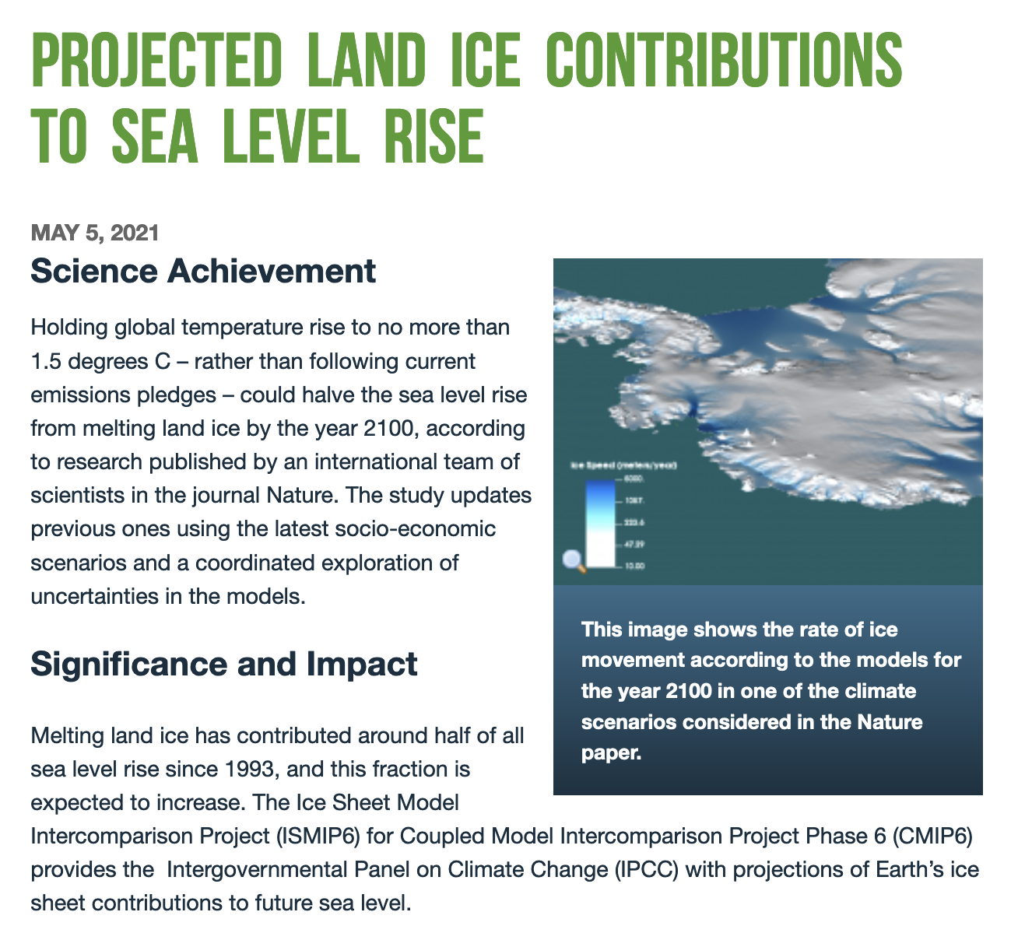
Attribution studies: mainly thermal expansion so far, but melting land ice is a growing fraction
(NERSC: https://www.nersc.gov/science/science-vignettes/projected-land-ice-contributions-to-sea-level-rise/)

Slide 4
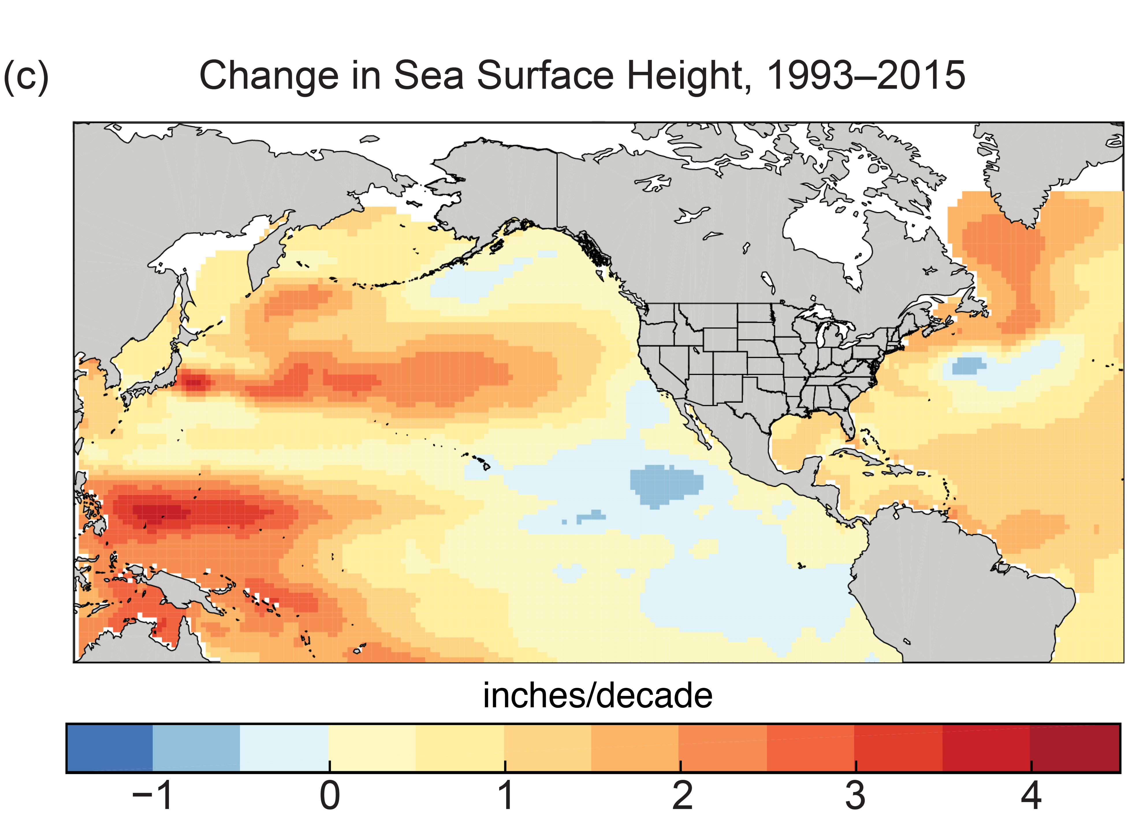
What we call “mean sea level rise” hides a lot of regional variability, however
https://science2017.globalchange.gov/img/figure/figure12_3.png

Slide 5
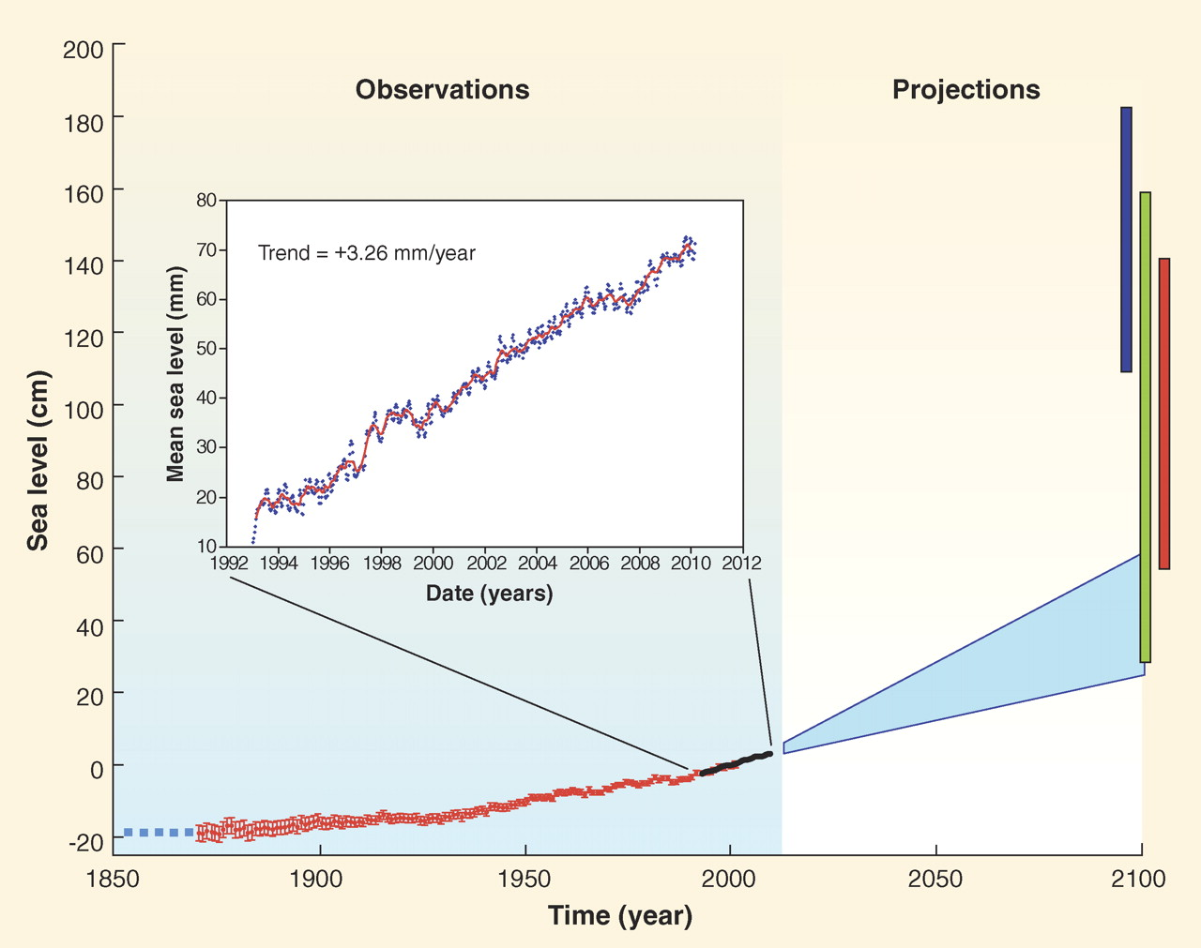
Projected effects of continued thermal expansion + melting land ice are pretty big
600 mm (60 cm)
200 mm (20 cm)
https://www.science.org/doi/10.1126/science.1185782

Slide 6
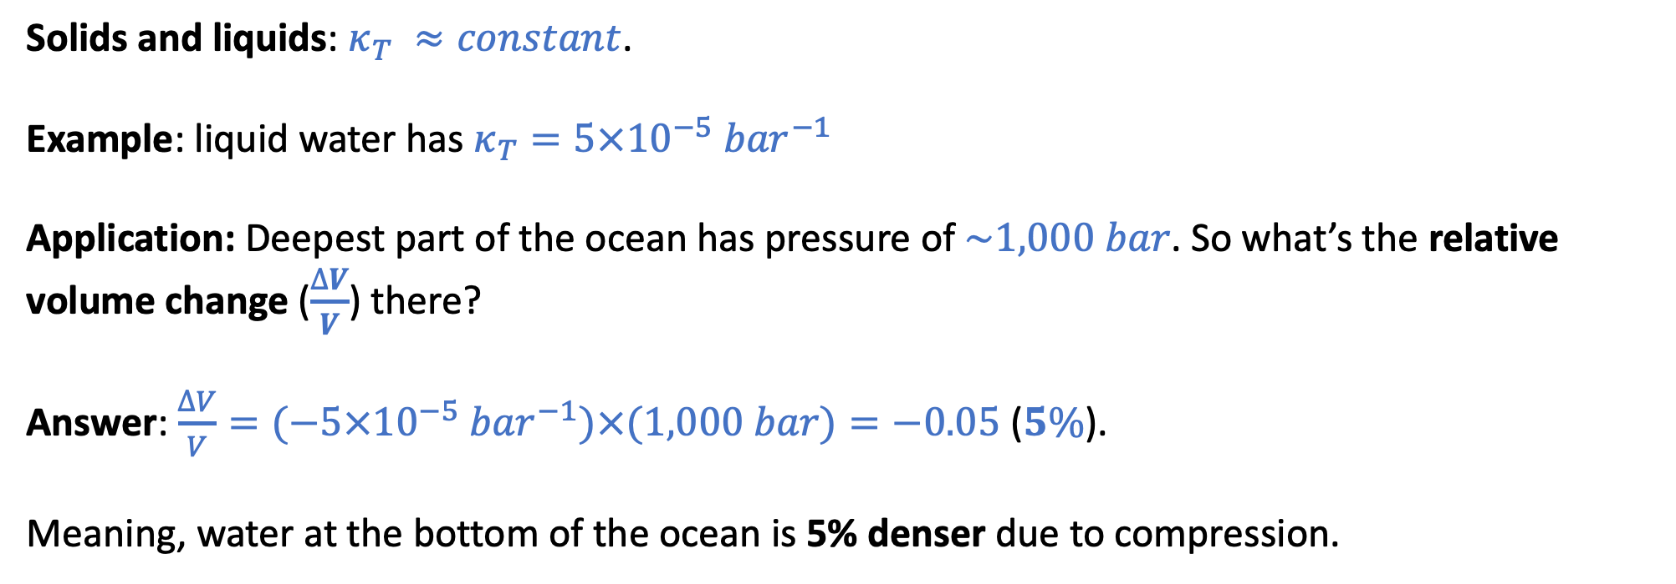
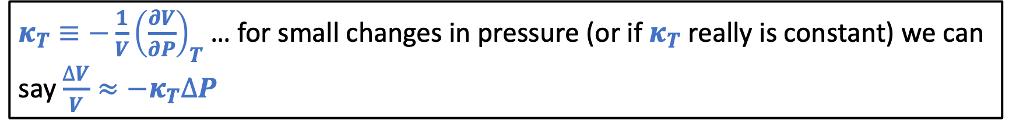
The “Isothermal compressibility”
$κ_{T}≡−\frac{1}{V}{\left(\frac{∂V}{∂P}\right)}_{T}$ … for small changes in pressure (or if $κ_{T}$ really is constant) we can say $\frac{∆V}{V}≈{−κ}_{T}∆P$
Solids and liquids: $κ_{T} ≈constant$.
Example: liquid water has $κ_{T}=5×10^{−5}{ bar}^{−1}$
Application: Deepest part of the ocean has pressure of $\sim 1,000 bar$. So what’s the relative volume change ($\frac{∆V}{V}$) there?
Answer: $\frac{∆V}{V}=(−5×10^{−5}{ bar}^{−1})×(1,000 bar)=−0.05$ ($5\%$).
Meaning, water at the bottom of the ocean is 5% denser due to compression.

Slide 7
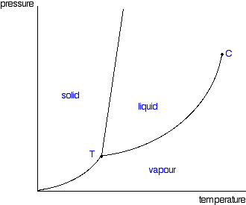
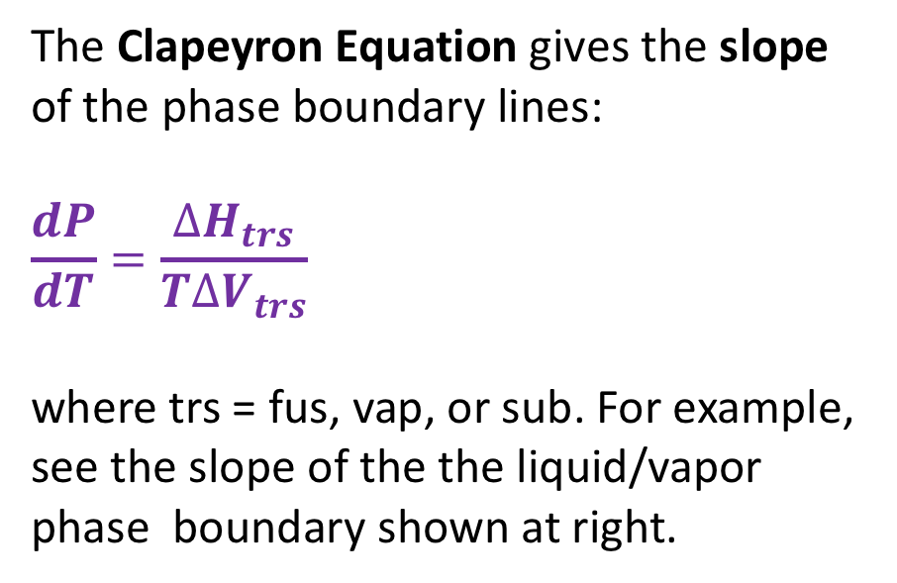
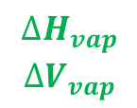
Clapeyron equation
The Clapeyron Equation gives the slope of the phase boundary lines:
$$\frac{dP}{dT}=\frac{∆H_{trs}}{T∆V_{trs}}$$
where trs = fus, vap, or sub. For example, see the slope of the the liquid/vapor phase boundary shown at right.
$$∆H_{vap}$$
$$∆V_{vap}$$
We’ll derive this equation later. For now we’ll just use it to obtain expressions for the phase boundary lines themselves – by integrating the slope.

Slide 8
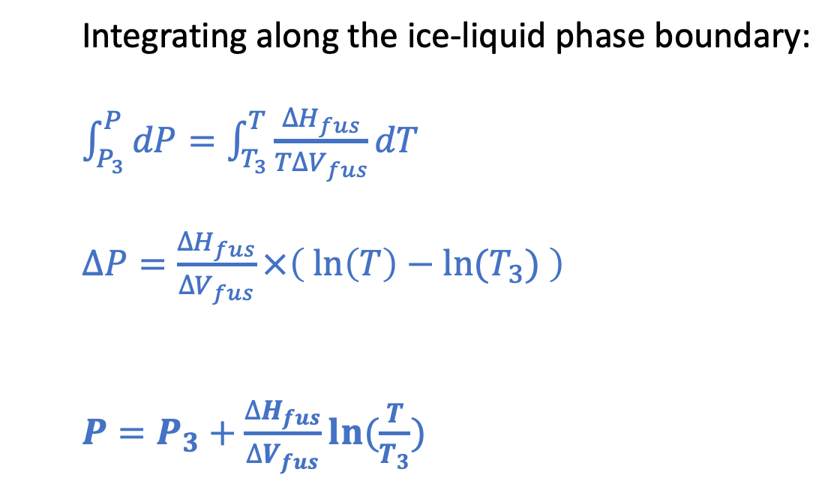
Thomson (for the ice-liquid phase boundary)
P
Integrating along the ice-liquid phase boundary:
$\int_{P_{3}}^{P}{dP}=\int_{T_{3}}^{T}{\frac{∆H_{fus}}{T∆V_{fus}}dT}$
$∆P=\frac{∆H_{fus}}{∆V_{fus}}×\left(\ln\left(T\right)−ln⁡(T_{3}) \right)$
$P=P_{3}+\frac{∆H_{fus}}{∆V_{fus}}ln⁡(\frac{T}{T_{3}})$
T

Slide 9
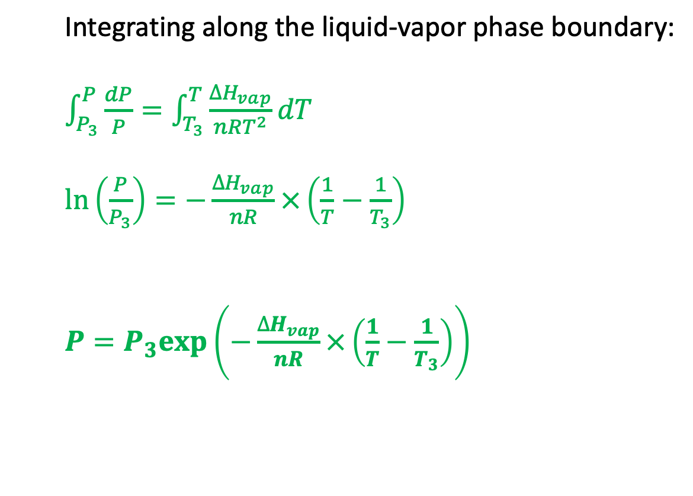
Clausius-Clapeyron (for the liquid-vapor phase boundary)
P
Integrating along the liquid-vapor phase boundary:
$\int_{P_{3}}^{P}{\frac{dP}{P}}=\int_{T_{3}}^{T}{\frac{∆H_{vap}}{nRT^{2}}dT}$
$\ln\left(\frac{P}{P_{3}}\right)=−\frac{∆H_{vap}}{nR}×\left(\frac{1}{T}−\frac{1}{T_{3}}\right)$
$P=P_{3}exp⁡\left(−\frac{∆H_{vap}}{nR}×\left(\frac{1}{T}−\frac{1}{T_{3}}\right)\right)$
T

Slide 10
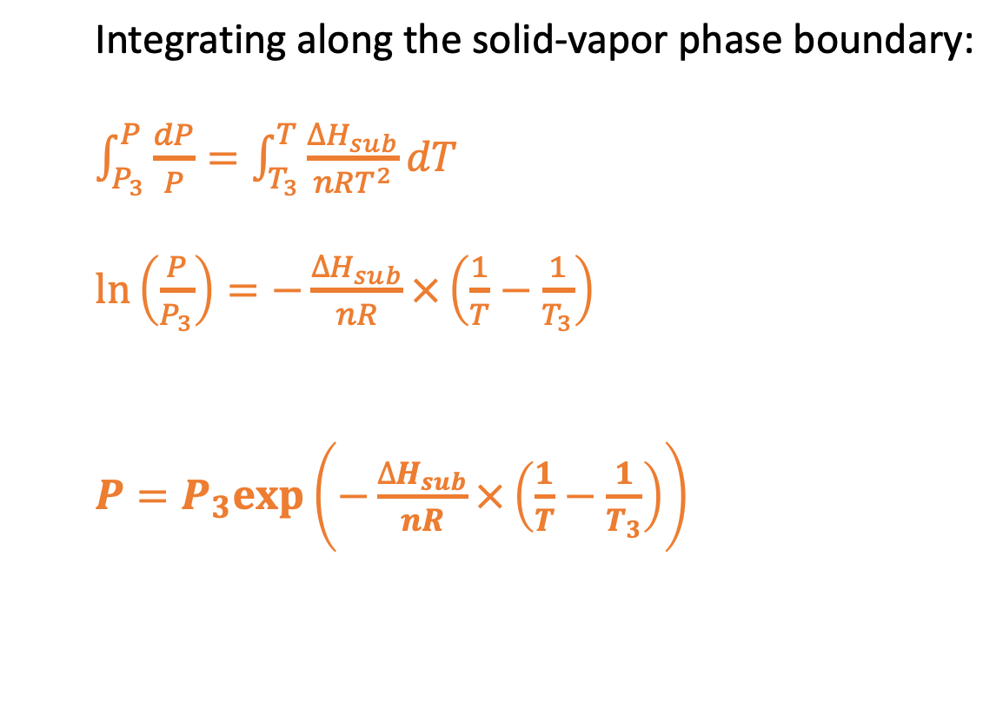
Clausius-Clapeyron (for the solid-vapor phase boundary)
P
Integrating along the solid-vapor phase boundary:
$\int_{P_{3}}^{P}{\frac{dP}{P}}=\int_{T_{3}}^{T}{\frac{∆H_{sub}}{nRT^{2}}dT}$
$\ln\left(\frac{P}{P_{3}}\right)=−\frac{∆H_{sub}}{nR}×\left(\frac{1}{T}−\frac{1}{T_{3}}\right)$
$P=P_{3}exp⁡\left(−\frac{∆H_{sub}}{nR}×\left(\frac{1}{T}−\frac{1}{T_{3}}\right)\right)$
T

Slide 11
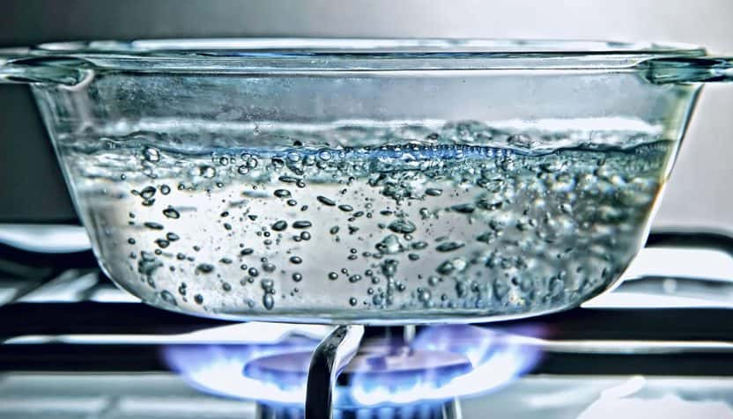
Boiling
P
Atmospheric pressure
Boiling happens when the vapor pressure of bubbles equals (or exceeds) atmospheric pressure.
T

Slide 12
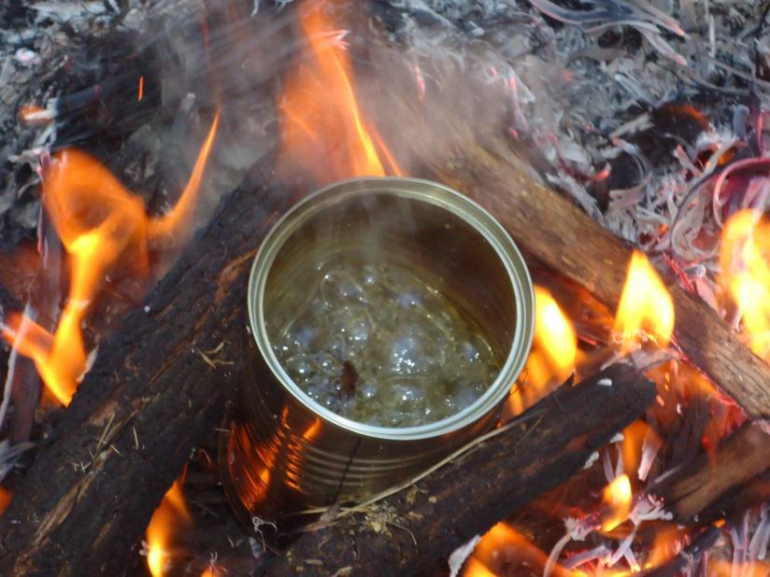
Boiling on Mt. Rainier
P
Atmospheric pressure
On Mt. Rainier
Boiling happens at a lower temperature on Mt. Rainier because atmospheric pressure is lower there.
T

Slide 13


How Raoult explains boiling point elevation
P
$$P_{H_{2}O}^{∗}$$
Standard atmospheric pressure
NaCl
$$P_{H_{2}O}^{∗}χ_{H_{2}O}$$
T
If you add salt to boiling water, it’ll stop boiling (for a moment, anyway) because ${P_{H_{2}O}^{∗}χ_{H_{2}O}<P}_{H_{2}O}^{∗}$.
With the burner on, the temperature will go up until $P_{H_{2}O}^{∗}χ_{H_{2}O}$ reaches atmospheric pressure again.

Slide 14
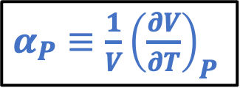
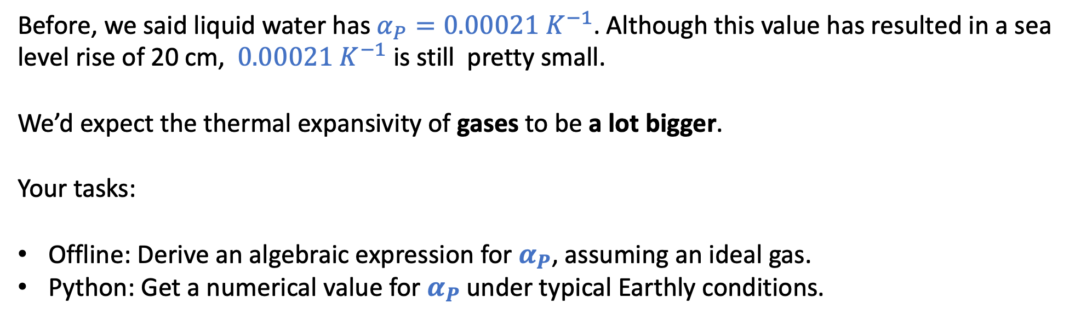
1. Isobaric thermal expansivity of an ideal gas
$α_{P}≡\frac{1}{V}{\left(\frac{∂V}{∂T}\right)}_{P}$
Before, we said liquid water has $α_{P}=0.00021{ K}^{−1}$. Although this value has resulted in a sea level rise of 20 cm, $0.00021{ K}^{−1}$ is still pretty small.
We’d expect the thermal expansivity of gases to be a lot bigger.
Your tasks:
Offline: Derive an algebraic expression for $α_{P}$, assuming an ideal gas.
Python: Get a numerical value for $α_{P}$ under typical Earthly conditions.

Slide 15
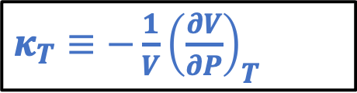
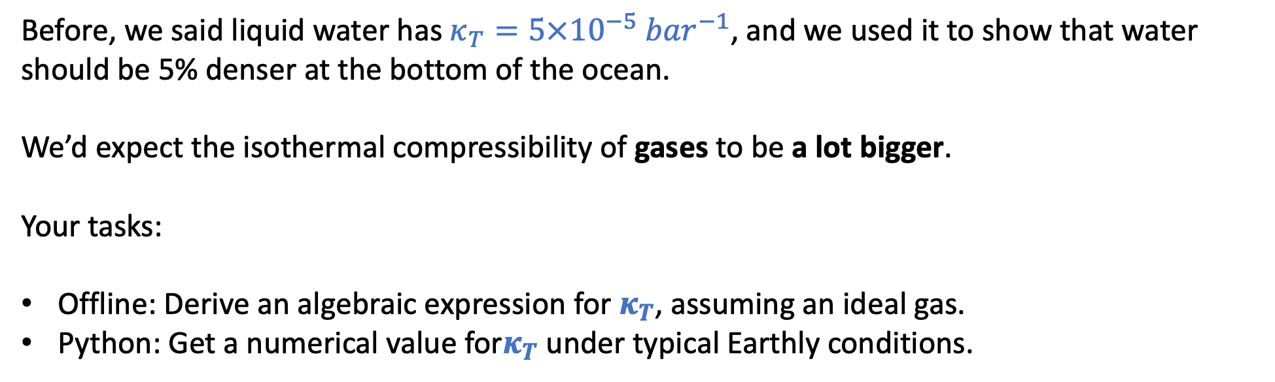
2. Isothermal compressibility of an ideal gas
$κ_{T}≡−\frac{1}{V}{\left(\frac{∂V}{∂P}\right)}_{T}$
Before, we said liquid water has $κ_{T}=5×10^{−5}{ bar}^{−1}$, and we used it to show that water should be 5% denser at the bottom of the ocean.
We’d expect the isothermal compressibility of gases to be a lot bigger.
Your tasks:
Offline: Derive an algebraic expression for $κ_{T}$, assuming an ideal gas.
Python: Get a numerical value for$κ_{T}$ under typical Earthly conditions.

Slide 16
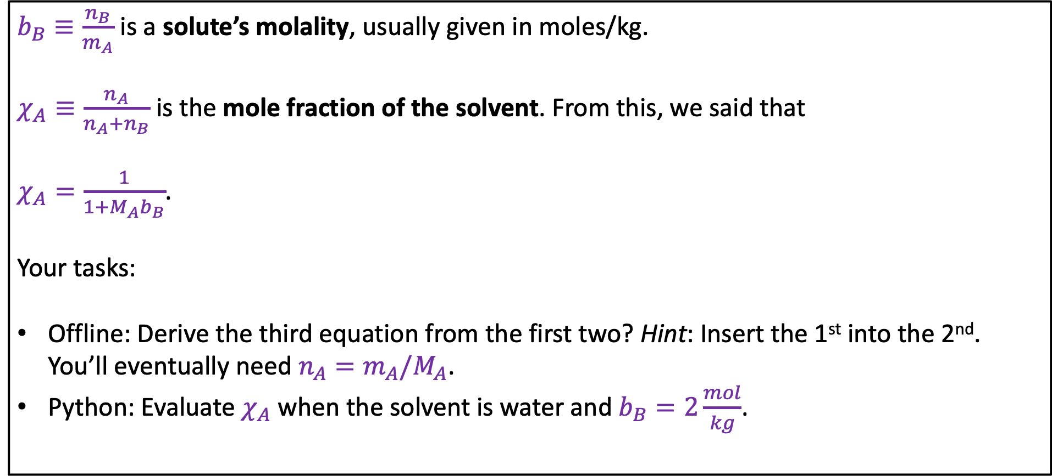
3. Molality and mole fraction
$b_{B}≡\frac{n_{B}}{m_{A}}$ is a solute’s molality, usually given in moles/kg.
$χ_{A}≡\frac{n_{A}}{n_{A}+n_{B}}$ is the mole fraction of the solvent. From this, we said that
$χ_{A}=\frac{1}{1+M_{A}b_{B}}$.
Your tasks:
Offline: Derive the third equation from the first two? Hint: Insert the 1st into the 2nd. You’ll eventually need $n_{A}=m_{A}/M_{A}$.
Python: Evaluate $χ_{A}$ when the solvent is water and $b_{B}=2\frac{mol}{kg}$.

Slide 17
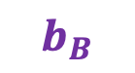
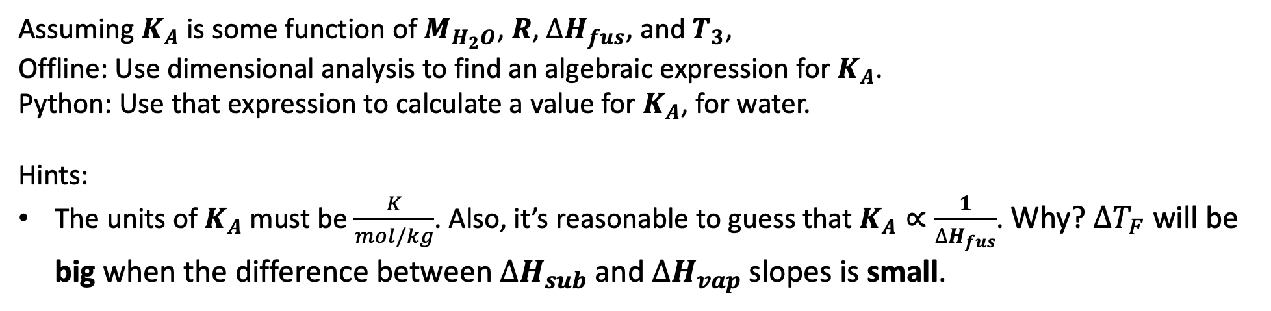

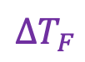
4. Deriving the cryoscopic constant $K_{A}$ using dimensional analysis
P
Blagden says $∆T_{F}=K_{A}b_{B} i_{B}$
$∆T_{F}$
T
$$b_{B}$$
Assuming $K_{A}$ is some function of $M_{H_{2}O}$, $R$, $∆H_{fus}$, and $T_{3}$,
Offline: Use dimensional analysis to find an algebraic expression for $K_{A}$.
Python: Use that expression to calculate a value for $K_{A}$, for water.
Hints:
The units of $K_{A}$must be $\frac{K}{mol/kg}$. Also, it’s reasonable to guess that $K_{A}∝\frac{1}{∆H_{fus}}$. Why? $∆T_{F}$ will be big when the difference between $∆H_{sub}$ and $∆H_{vap}$ slopes is small.

